Slide 1
Project management
and the RI Life Cycle

Slide 2
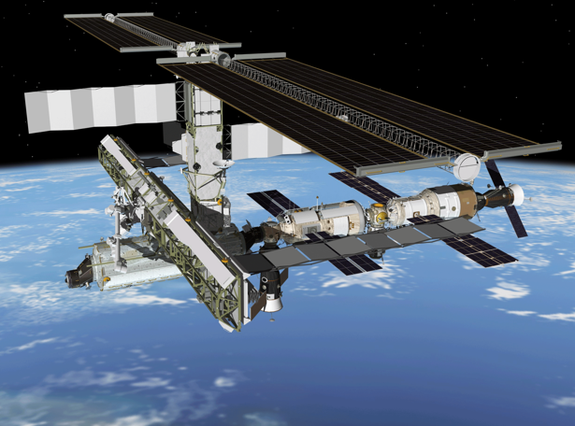
ISS
Managing a complex project,
. . . and the result

Slide 3
Project Management =
planning
organising
securing
controlling resources
leading and managing
to achieve defined goals of a (time/resource) limited project

Slide 4
The ideal sequence of RI project phases
Preparations
Construction
Operations
Decommisioning
The reality
Preparations
Construction
Operations
Transition Phase

Slide 5
Management considerations
Who is in charge and makes the decisions?
Who is paying?
Who is managing?
How to secure continuity?

Slide 6
The ideal project time line
Initiation
Planning and
design
Execution
Monitoring
And Controlling
Closing

Slide 8
Project management methodologies - 1
Waterfall model (for example PRINCE2)
one series of subprojects (tasks) after another in linear sequence
each process is specified with its key inputs and outputs and with specific goals and activities
works well for small, well defined projects

Slide 9
Project management methodologies - 2
Critical chain project management
Is considering resource limitation as key parameter,
to reduce uncertainties
Identify priority tasks in the critical chain

Slide 11
Project management methodologies - 3
Event chain methodology
Consider probably of (external) disruptions and risks
Manage on mitigating (potential) negative impacts rather than the project process itself

Slide 12
Project management methodologies - 4
Agile project management
all small project tasks are conceived and executed in an adaptive manner
and rather than as a completely pre-planned process

Slide 13
New additions
while executing
the project

Slide 14
Initiation
Planning and
design
Execution
Monitoring
And Controlling
Closing

Slide 15
Planning and design
Design specification, process steps, internal/outsourced activities
What kind of project planning (waterfall etc?)
Identify deliverables and work breakdown
Identify activities required to deliver
Estimate resource requirements and match with budget and time
Organise rick planning
Select project team, suppliers and management
Get approval

Slide 16
Execute and produce
Complete each task within budget and time
Coordinate people and resources
Integrate with conditional and dependent other tasks
Document processes and deliverable results
Communicate

Slide 17
Monitoring and controlling
Measuring “where are we?”
Monitor variables (cost, effort, scope) against the plan
Identify corrective actions to address
Check feed back with related tasks
Consider updates

Slide 18
Into operation or closure
Formal acceptance of delivery and end of (sub) project
Closure, when no or not sufficient delivery
Archive “lessons learned”
Re-locate staff and settle any contracts

Slide 19
RI project management
Projects may involve:
  A new research infrastructure
  A machine
  A sensor network
  Interoperable databases and tools
  The RI service organisation
  A user involvement programme
  A (new) user selection procedure
Consider in which phase the project is running
  Preparations, transition to construction, construction, upgrade, decommission
Be aware of:
  Who is in charge and makes the decisions?
  Who is paying?
  Who is managing?
  How to secure continuity?

Slide 20
Perspectives in
RI project management
Manage product development and delivery
Manage distributed (tendered and in-kind) contributions
Manage performance and risks
Manage expectations of multiple stakeholders -> strategies
Manage the project organisation
Manage accountability
Manage the management

Slide 21
Case studies
Group A: INCF
International Neuroinformatics Coordinating Facility
(10 – 15 persons, and many distributed facilities)
Group B: KM3Net
(250 persons)
Group C: LHC
Large Hadron Collider
(> 10.000 persons)

Slide 22
Report to Governing Board
How is the leadership structured through the phases of the project?
How are roles and responsibilities allocated in the leadership?
Which project organization will secure timely delivery within the budget?
More specifically, which arrangements should be in place for managing in-kind contributions and outsourcing?
How is risk management positioned in the project?
Group work from 09:40 – 11:00 h.
Assign chair person and a rapporteur (this is the project director)
Reporting at 12:15 h. (10 minutes for each rapporteur)

