Slide 1
Managing an established facility
Introduction
Kimmo Koski
CSC, Finland
June 2012

Slide 3
Learning goals
Practical examples in running an established facility
Best practices
Sharing of information
Combining the different parts of RAMIRI together
Understanding the characteristics of established RI
Need for continuous development

Slide 4
Contents of the session
Introduction (Kimmo Koski)
General topics
Case CSC
Case EMBL and Elixir (Silke Schumacher)
Case Elettra (Carlo Rizzutto)
Collaboration possibilities (Michele Bertolo)
Industry collaboration (Marco Marazzi and Ileana Gimmillaro)
Panel for questions

Slide 5
Noble targets towards successful RI
Keep the constant development going on
Financial innovation
Technical work
Organization
Plan before how to react in changing situations
Ensure the commitment of funding bodies, users, partners, …
Invest in people and in their competencies, keep a good team spirit
Put time to strategy work and roadmaps of core services

Slide 6
What do you need to consider when running a center?
Sustainability
Project funding vs. ‘sustainable’ funding
Customer base and services
Ability for long-term planning
Organization and steering structures
Strategy and implementation
Communication (external and internal)

Slide 7
Make sure this works
Financing
HR
Customer relations
Stakeholder management
Services and their development
Decision making process
Target setting for individual employees, groups, the whole company
Internal communications
Strategic planning

Slide 8
Some examples of organizing a facility

Slide 9
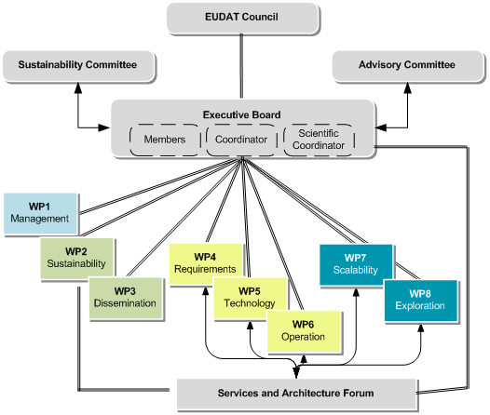
EUDAT Project Governance

Slide 10
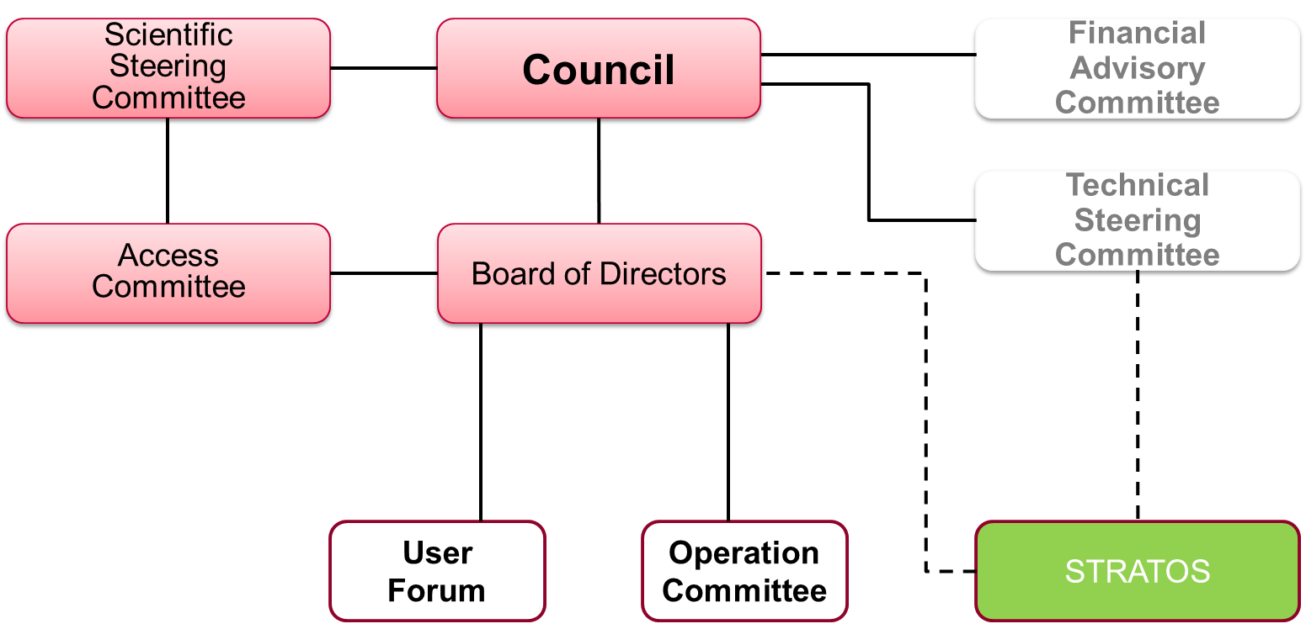
PRACE AISBL Organization
Council Chair:
Catherine Riviere

Slide 11
Case CSC

Slide 12
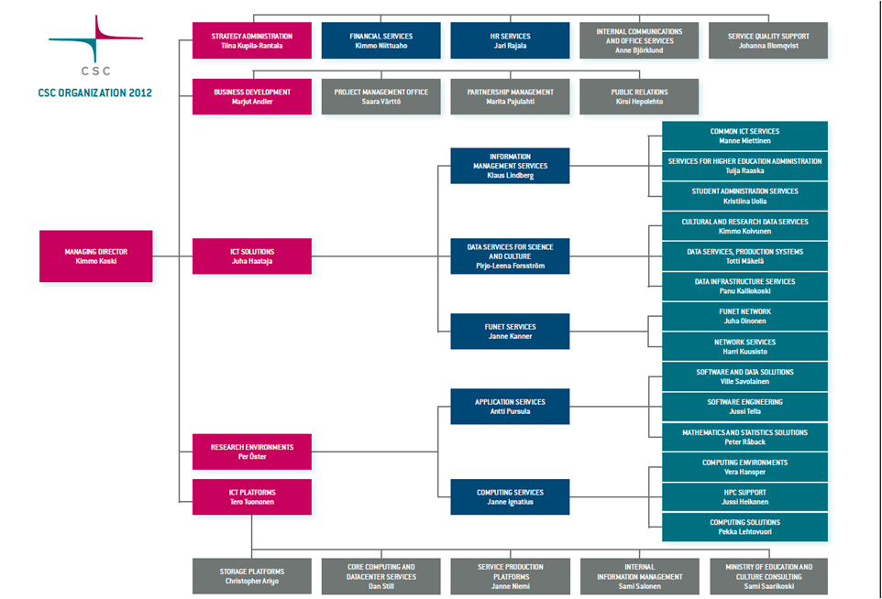

Slide 13
CSC’s Services
Funet Services
Computing Services
Application Services
Data Services for Science and Culture
Information Management Services
Universities
Polytechnics
Ministries
Public sector
Research centers
Companies

Slide 14
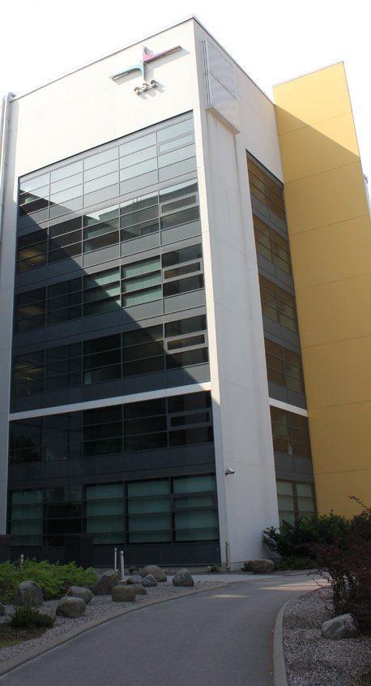
CSC at a Glance
Founded in 1971 as a technical support unit for Univac 1108
Connected Finland to the Internet in 1988
Reorganized as a company, CSC – Scientific Computing Ltd. in 1993
All shares to the Ministry of Education and Culture of Finland in 1997
Operates on a non-profit principle
Facilities in Espoo, close to Otaniemi campus (of 15,000 students and 16,000 technology professionals) and Kajaani
Staff 240
Turnover 2012 exceeding 30 million euros

Slide 15
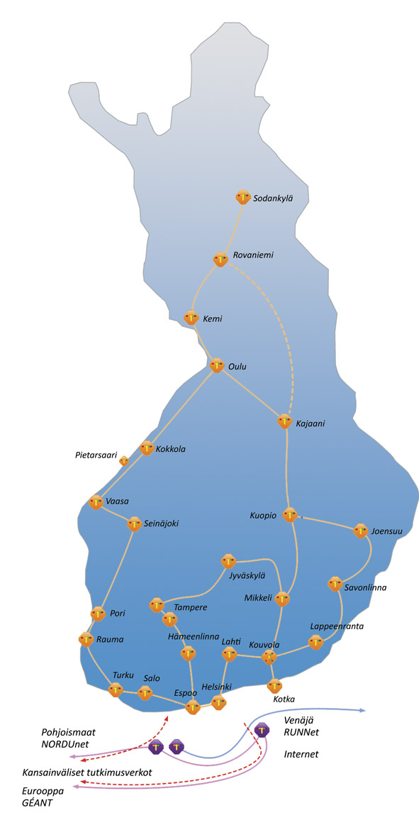
Funet Services
The Finnish research and education network, Funet provides national and international high-capacity data communications connections to all higher education institutions in Finland and for 37 state research institutes and other organizations.
Network Services and Light paths
Network Security – Funet CERT
eduroam – wireless network roaming
Haka-identity Management
Campus Support
The NORDUnet network provides access to all international services and links to global research networks.

Slide 16
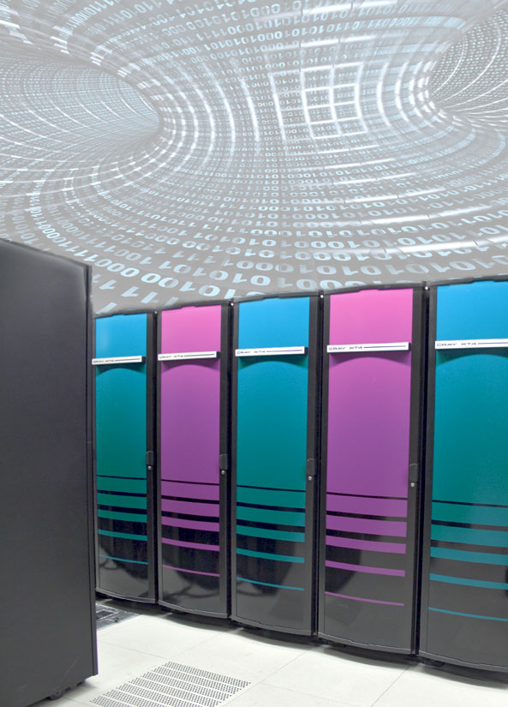
Computing Services
Maintains and develops a high-profile computing environment to meet research needs. Computing Services offers researchers and higher education institutions expertise in scientific computing and IT consulting, including algorithm design, code optimization, and parallelization, computing projects, and acquisition of server hardware.
Cray XT4/XT5 (Louhi)
Massive computational challenges
>10 000 cores, >11TB memory
Theoretical peak performance >100 Tflop/s
HP-clusters (Murska, Vuori)
Small and medium-sized tasks
Theoretical peak performance >40 Tflop/s
Application servers (Hippu)
Interactive applications and large-memory tasks
4 servers with 0.5-1TB of shared memory
The computing environment will be updated in 2012.

Slide 17
Application services
Enables researchers to efficiently utilize IT infrastructures, such as local and distributed computing platforms, by providing wide selection of scientific applications, databases and interfaces as a service
Provides training events and expert support on usage of the software as well as on methodology, including modeling, algorithms and statistical methods
Develops software products which combine state of the art features and user-friendly interface
Develops software for managing and analyzing large research datasets
Develops and supports Scientist’s User Interface – the portal to CSC services

Slide 18
Data services for science and culture
Provides customers with high-quality, secure and reliable services for storage, analysis, management and common use of digital information. The guiding principles in the service provision are data availability, privacy, integrity and longevity.
Pioneering in Digital Preservation and Data for Research
Nationwide collaboration via Data for Research (TTA) and National Digital Library (KDK)
International collaboration via EU projects (EUDAT, APARSEN, ODE, SIM4RDM)
Database and information services
Paituli: GIS service
Nic.funet.fi – Serving freely distributable files with FTP since 1990
CSC Stream
Database administration services
Tailored IT services and extensive consultation services for memory organizations
Finnish university and polytechnics libraries
Finnish National Audiovisual Archive
Finnish National Archives
Finnish National Gallery

Slide 19
Information management services
Supports the national science and education policy and academic management and administration by providing IT consulting and planning and cost-effective hosting services for shared and centralized information systems
Reliable, cost-effective and centralized information technology services
Centralized data management services
Maintenance and development
Haka user identification system
Consultancy services
Expertise in higher education CSC information systems especially for state administration of education and science.
Haka, KOTAPLUS, AMKOTA

Slide 20
Broad National Cooperation
Universities
Universities of Applied Sciences
Ministry of Education and Culture
Other ministries
Tekes, the Finnish Funding Agency for Technology and Innovation
Academy of Finland
Finnish Meteorological Institute
National Audiovisual Archive
National Library
Nokia
Okmetic etc.

Slide 21
EU Projects 2012

Slide 22
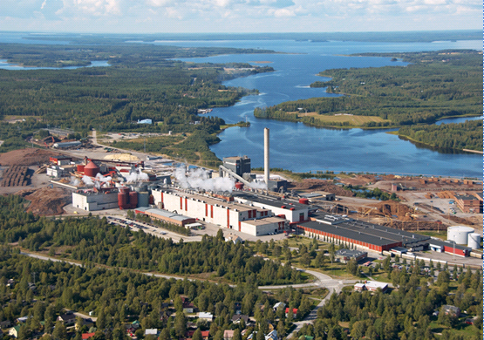
Kajaani Data Center
CSC’s modular Data Center in Kajaani. Modern and reliable infrastructure (national power grid, roads, airline connections, data networks)
The Funet Network ensures excellent networking capabilities around the world
Place for CSC’s next supercomputer with other CSC customer systems
World class education system and competences on ICT & energy

Slide 23
Reacting to the dynamic changes

Slide 24
Typical challenges to solve
Key person leaves, it takes time to recruit new
Needs fast reaction time, pre-scanning of risks in personnel, efficient HR, take care of the customer
Budget cuts
Fast priority settings with real implications, impacts for short term/long term, actions for savings AND increasing funding
Personnel is overloaded
Restructuring workload, priority settings, check the ‘booking’ of the most wanted person resources

Slide 25
Other challenges
Steering bodies try to make decisions for operational matters
Get angry and show it!
Atmosphere in the company is stressed and tight, people quarrel
Organize a party!
The credit of your achievements is pretty much taken in public by people above you
If you are CEO, be happy (the decision makers like you)
If you are an employee, shout loud!
The government states that there is a need for a major reorganization of the national ICT support structure
PANIC! ☺

Slide 26
Important
Be aware what your customers need and want
If you do not know, ask them
Customer driven services usually better approach than technology driven
Infrastructures have been closed down due to forgetting the customer
Be proactive towards the bodies that govern and fund you
Get to know their targets and current interests

Slide 27
RI manager’s Fault Finding Chart
Observation | Potential reason | Actions to be taken
You suddenly find that you have money for yet another synchrotron | Your hand is in someone else’s pocket. | Propose him/her a collaboration project with joint funding
Everything has gone dark | You have forgotten to pay the electricity bill | Make a press release stating that you contribute to the environment by using less electricity
Everything else has gone dark, except you office | It is night and you once again have forgotten to go home | Get some sleep
Everything seems to work slow and looks old fashioned | You are in an antique shop | Go out and find your office from the street next to it
People around you smile and look happy | You have forgotten to dress before getting to work | Pretend that it is a theme day at work (‘casual Friday’)

Slide 28
Remember that facilities evolve over time
Differences in lifecycles
ICT equipment 3-5 years
Synchrotron etc. tens of years
Various states: lobbing, launching, ramping up, growing, decreasing, crises/opportunities, renewal of RI, decommissioning, …
Preparation with a good strategy is important, as also keeping the eyes open and listening to the signals from external world

Slide 29
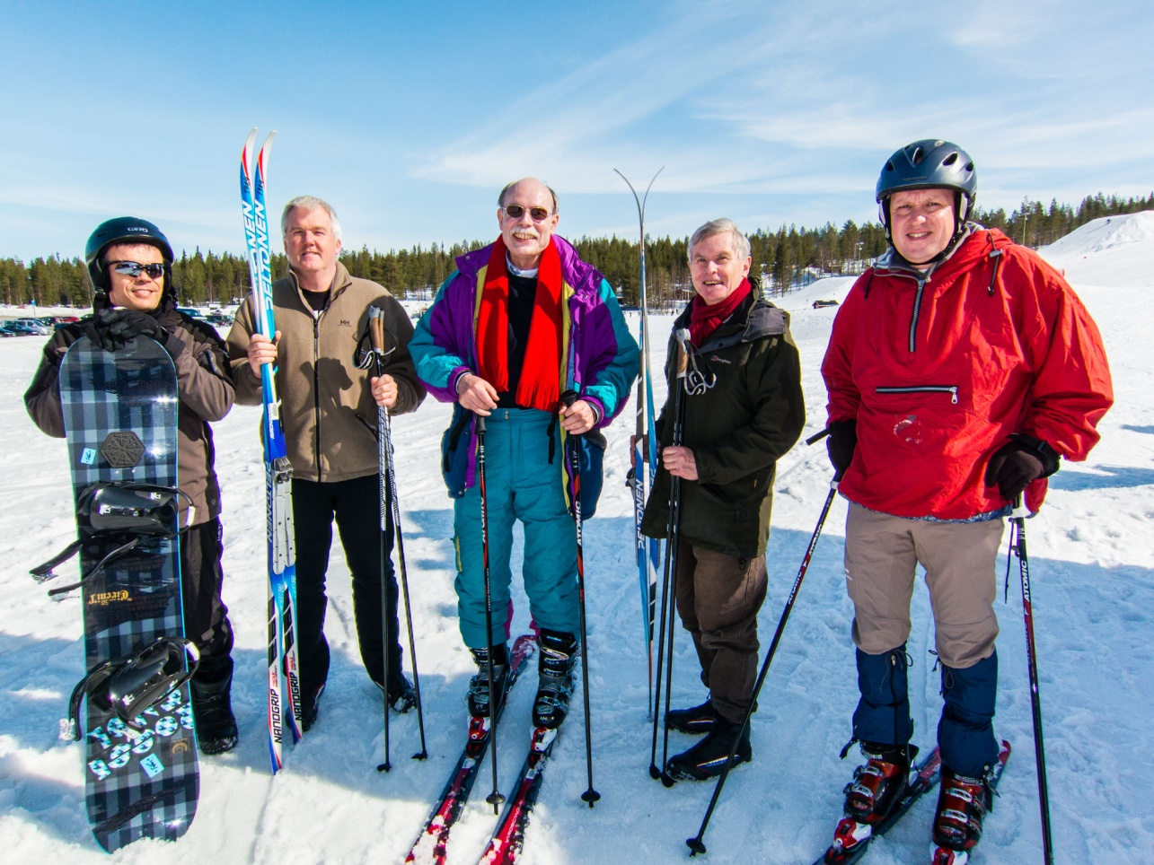
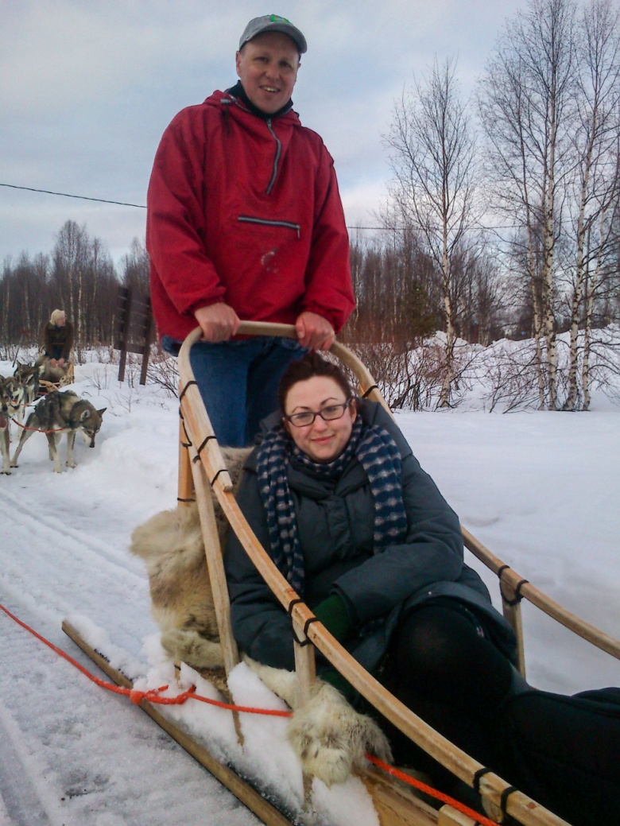
Thank you!
RAMIRI (Recreation Activities in MIddle of nowhere, far away from Research Infrastructures)

Slide 30
Questions for Panel
Speakers as panelists
Questions:
Can be given in advance in paper or sent by email (Kimmo.Koski@csc.fi) during the break
Or just ask during the panel

