Slide 1
Legal issues of distributed
research infrastructures

Slide 2
What is a distributed research infrastructure?
ESFRI
When a research infrastructure is structured with more than one site it can be defined as a distributed infrastructure.
A European distributed infrastructure is a singular research infrastructure, having a unique name and legal status, etc.
ERIC Council regulation
Art 2 (definitions): ... Such infrastructures may be ‘single-sited’ or ‘distributed’ (an organised network of resources)

Slide 3
Models of distributed research infrastructures
Loose interconnected network nodes.
One (or a few) nodes support the coordination of
common operations.
Hub and spokes with dependent operational relations.
But spokes are not necessarily “owned” by the hub.
Often e-Infrastructures.
Multiple sites infrastructure, with different places of operation
and a coordinating mechanism.

Slide 4
Mixed model
Distributed independent
entities, but crucial for
infrastructure operations
Distributed entities’owned’ by
The research infrastructure

Slide 5
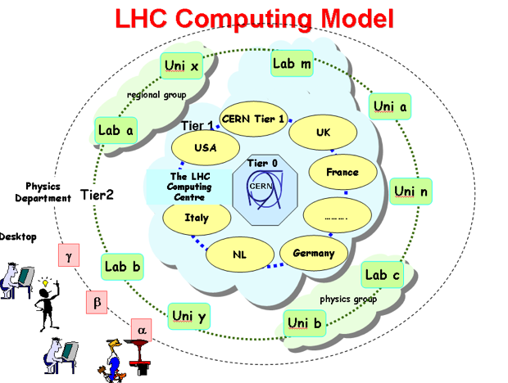
e-infrastructures especially often depend on the operations of other facilities, not necessarily part of the infrastructure’s legal entity.

Slide 6
How to regulate crucial relations with ‘not owned’ facilities?
Country
Legal relation
+
Provisions for MoU
Secure the supporting
operations of the
national facilities
Research
Infrastructure
External
Facility
Service Level Agreement
-> Operational relation

Slide 7
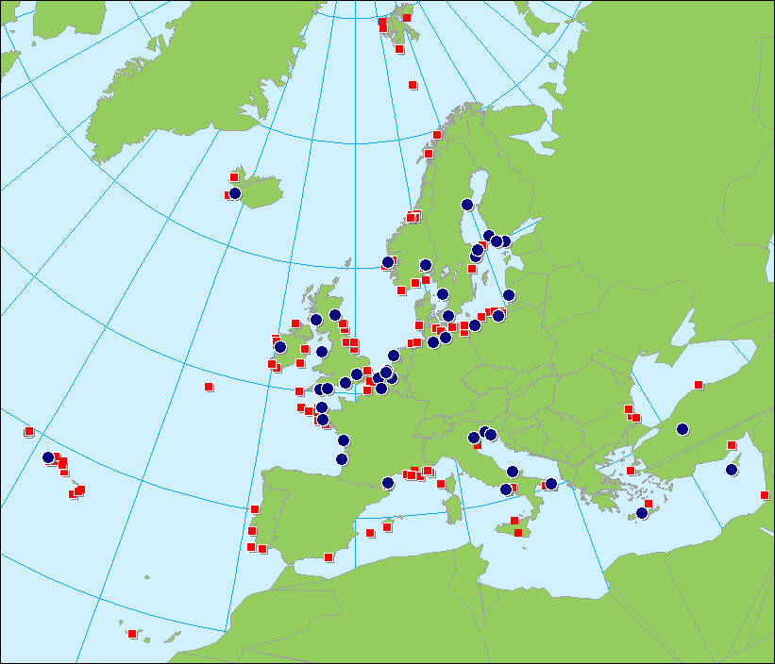
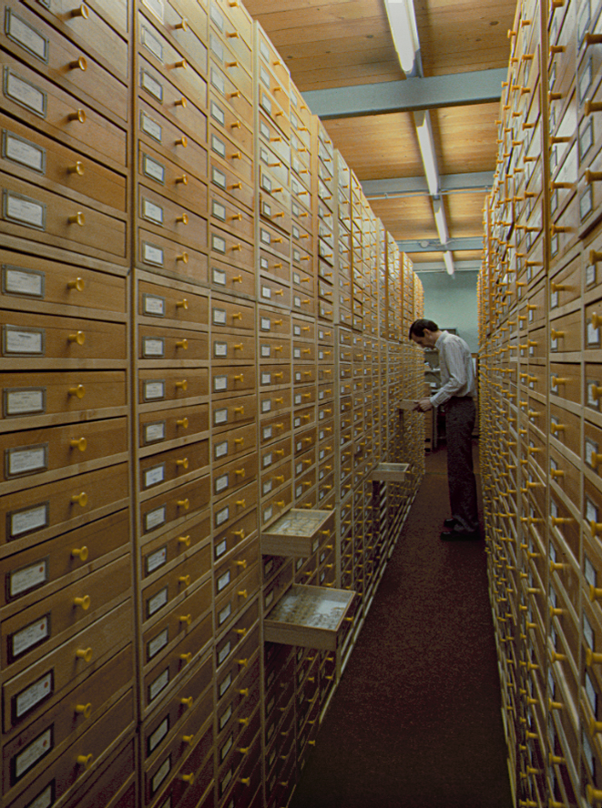
Distributed data generation
Terrestrial
monitoring
Marine
monitoring
Natural science
collections
Earth
observation
Notes:
7
7

Slide 8
Research
Infrastructure
Applications
Analysis/
Modelling
Data integration
Data management
Data generation
(digitizing; sampling;
sensoring
Data filtering
in national
computing centres
Large Hadron Collider
case
Distributed
(independent)
Data generators
LifeWatch case

Slide 9
Infrastructure
Central
Facilities
Distributed
facility
Distributed
facility
Distributed
facilty
Distributed
facility

Slide 10
Countries
Governing Board
ERIC
organisation
(Independent)
Centres
Service level agreements
Executive
Management
Operational relations
Community (individuals)
“Apache” model, formalizing community power

