Slide 1
RAMIRI 2 Prague, 12-14 March 2012 Legal and governance issues: ESRF and European XFEL as examples of single-site facilities
Karl Witte Hamburg

Slide 2
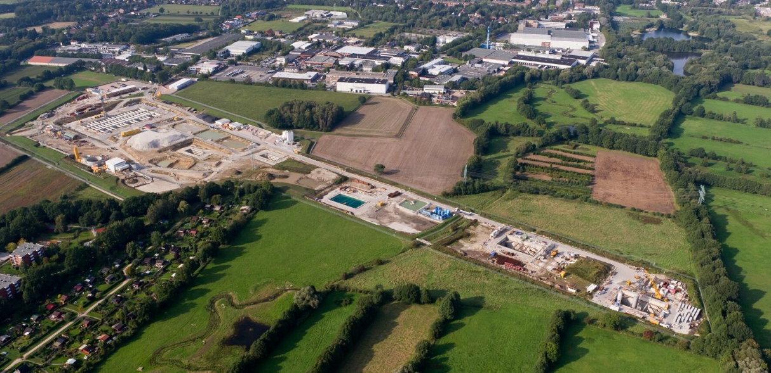
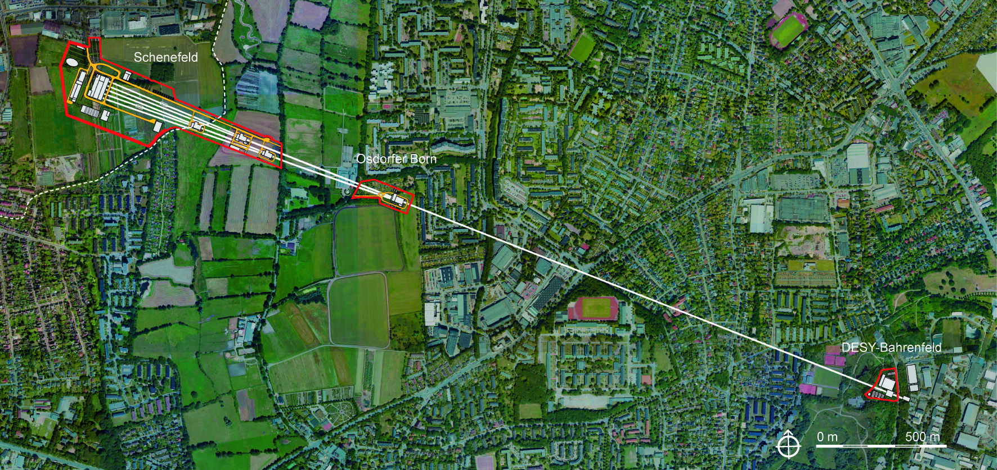
Introduction to some scientific and technical basics of …
… ESRF
…European XFEL

Slide 3
Legal Organisation of ESRF and XFEL Mission …
… of the ESRF:
to construct, operate and develop a synchrotron radiation source and associated instruments
to support the use of the Facility
to implement programmes of scientific research using SR
to carry out R&D work in techniques using SR
… of the European XFEL:
to construct, operate and develop a linear accelerator based Free-Electron Laser and associated instruments (the “XFEL Facility”)
to support the use of the Facility
to implement programmes of scientific research using the facility
to carry out R&D work on the accelerator, the FEL process and experimental techniques
to ensure technology transfer, general public outreach and knowledge transfer

Slide 4
Legal Organisation of ESRF and XFEL Preparatory phase covered by Memorandum of Understanding
for the ESRF:
Only five countries participate: FR, DE, IT, UK, ES (all of them become contracting parties)
Duration of MoU phase was limited from the outset (two years)
Fixed budget for MoU phase (contributions later on taken into account as part of construction costs)
Objective: Decision on start of construction, otherwise abandonment of the project
for the European XFEL:
Successively 14 countries join: DE, FR, IT, UK, ES, RU, PL, SE, DK, CH, SK, HY, CN, GR (of which CN and UK eventually did not sign the Convention)
Duration of MoU phase without limit
No fixed MoU budget, funds essentially advanced by DE, major part taken into account as part of construction cost

Slide 5
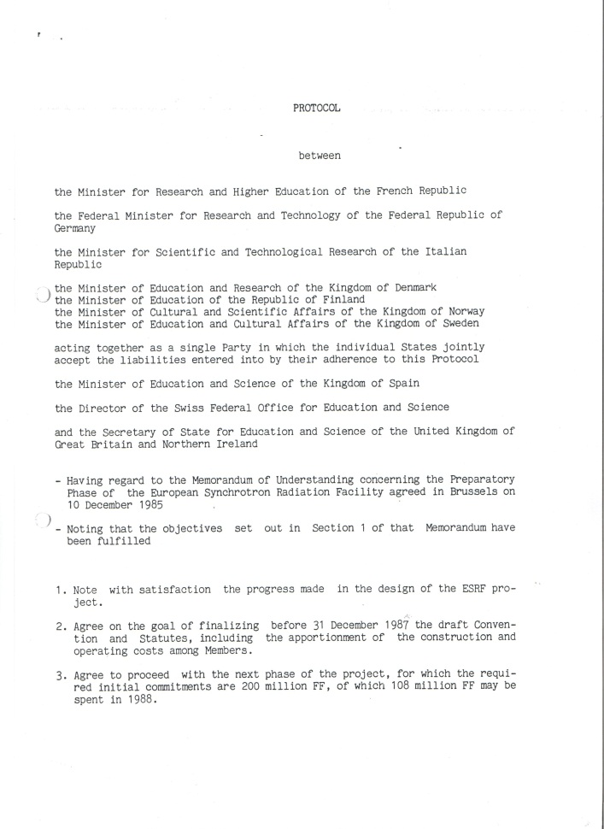
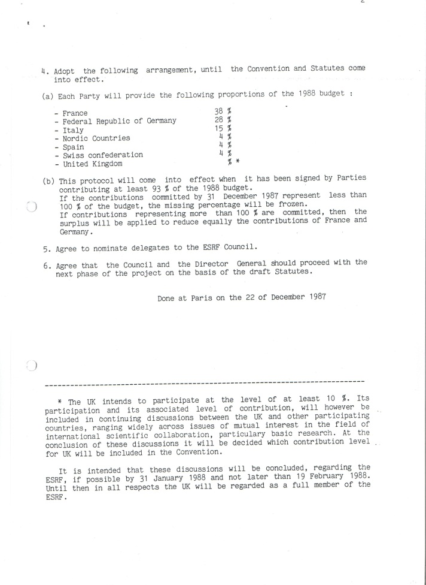
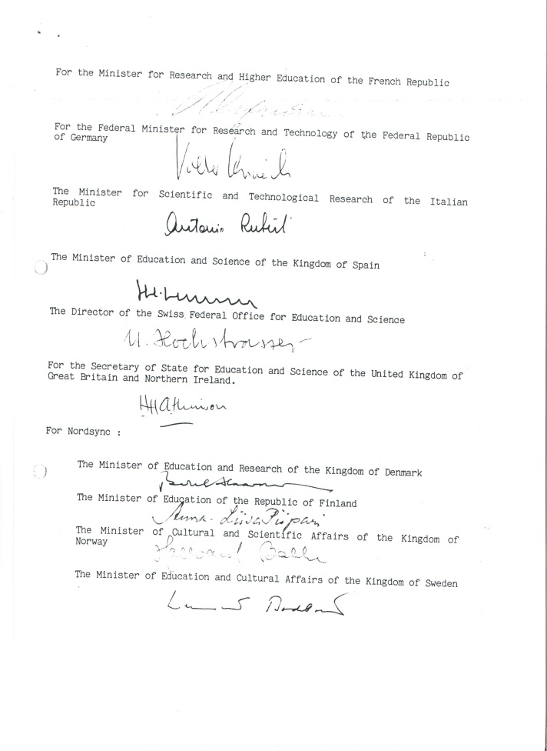
Legal Organisation of ESRF and XFEL After expiry of MoU on ESRF:
Start of construction of ESRF in January 1988, based on “Protocol” of three pages, including signatures, signed on 22 December 1987

Slide 6
Legal Organisation of ESRF and XFEL here: ESRF, first level
Comparison of legal difficulties/advantages of ESRF and European XFEL
Convention:
Twelve Governments (Contracting Parties)
“… decided to promote
France
Spain
the construction and operation of a European synchrotron radiation facility
Germany
Switzerland
Italy
housing a high performance source of X-rays for the use of their scientific communities.”
Denmark
United Kingdom
Finland
Belgium
Norway
The Netherlands
Sweden
signed Convention on 16 Dec 1988

Slide 7
Legal Organisation of ESRF and XFEL here: ESRF, first level
Comparison of legal difficulties/advantages of ESRF and European XFEL
Convention signed by 12 Governments (Contracting Parties)
France
Spain
“The construction and operation of the European synchrotron radiation facility
Germany
Switzerland
Italy
shall be entrusted to a Société Civile … which shall be subject to French law.
Denmark
United Kingdom
Finland
Belgium
The members of the Company shall be … designated … by each Contracting Party.”
Norway
The Netherlands
Sweden

Slide 8
Legal Organisation of ESRF and XFEL here: ESRF, second level
Comparison of legal difficulties/advantages of ESRF and European XFEL
Contracting Parties designate Members (threshold: 4%)
France
CEA
CNRS
Kingdom of Spain
Spain
Germany
DESY
Swiss Confederation
Switzerland
Italy
CNR
INFN
INFM
Denmark
United Kingdom
CCLRC
Finland
NORDSYNC
Belgium
Norway
BENESYNC
ESRF
The Netherlands
Sweden

Slide 9
Legal Organisation of ESRF and XFEL here: ESRF, second level
Comparison of legal difficulties/advantages of ESRF and European XFEL
Contracting Parties designate Members (threshold: 4%)
France
Spain
CH
Spain
Germany
NORDSYNC
Switzerland
Italy
BENESYNC
Denmark
France
United Kingdom
UK
Finland
Belgium
Germany
Italy
Norway
The Netherlands
Sweden
Shares = contributions to operating costs = voting rights

Slide 10
Comparison of legal difficulties/advantages of ESRF and European XFEL
Legal Organisation of ESRF and XFEL
Why société civile?
Legal identity under national law in order to avoid high cost of intergovernmental institute
Wide scope for legal embodiment
Location besides ILL (= société civile) ⇨ similar rules for personnel
A very similar approach had been intended for the European XFEL Facility.

Slide 11
Legal Organisation of ESRF and XFEL here: European XFEL, first level (planned)
Comparison of legal difficulties/advantages of ESRF and European XFEL
Convention:
Fourteen Governments (= Contracting Parties)
Germany
United Kingdom
Sweden
“… decide to promote
France
the construction and operation of a European X-ray Free-Electron Laser Facility
Denmark
Italy
Russia
housing a superconducting linear accelerator, radiation beamlines and experimental facilities for the use of the scientific communities.”
Spain
Poland
Switzerland
Hungary
Slovakia
China
Greece

Slide 12
Legal Organisation of ESRF and XFEL here: European XFEL, first level (planned)
Comparison of legal difficulties/advantages of ESRF and European XFEL
Convention:
Fourteen Governments (= Contracting Parties)
Germany
United Kingdom
“The construction and operation of the European X-ray Free-Electron Laser Facility
Sweden
France
Denmark
shall be entrusted to a Limited Liability Company … which shall be subject to German law.
Italy
Russia
Spain
Poland
The Shareholders of the Company shall be … designated … by the Contracting Parties.”
Switzerland
Hungary
Slovakia
China
Greece

Slide 13
Legal Organisation of ESRF and XFEL here: European XFEL, second level (planned)
Comparison of legal difficulties/advantages of ESRF and European XFEL
Thirteen Governments designate Shareholders
Germany
United Kingdom
STFC
DESY
VR
Sweden
France
CNRS
CEA
DASTI
Denmark
Italy
Republic of Italy
RUSNANO
Russia
Spain
Kingdom of Spain
IPJ
Poland
Switzerland
Swiss Confederation
NKTH
Hungary
Slovakia
European
XFEL
IHEP
China
Slovak Republic
Greece

Slide 14
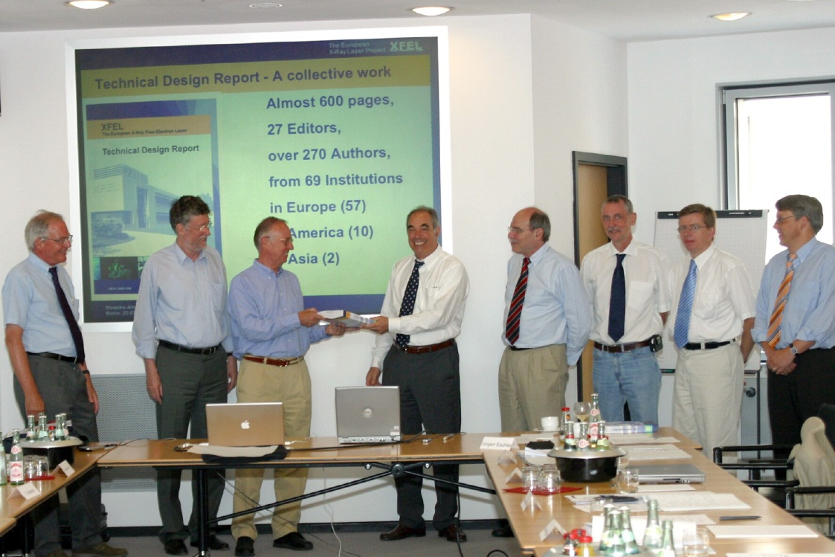
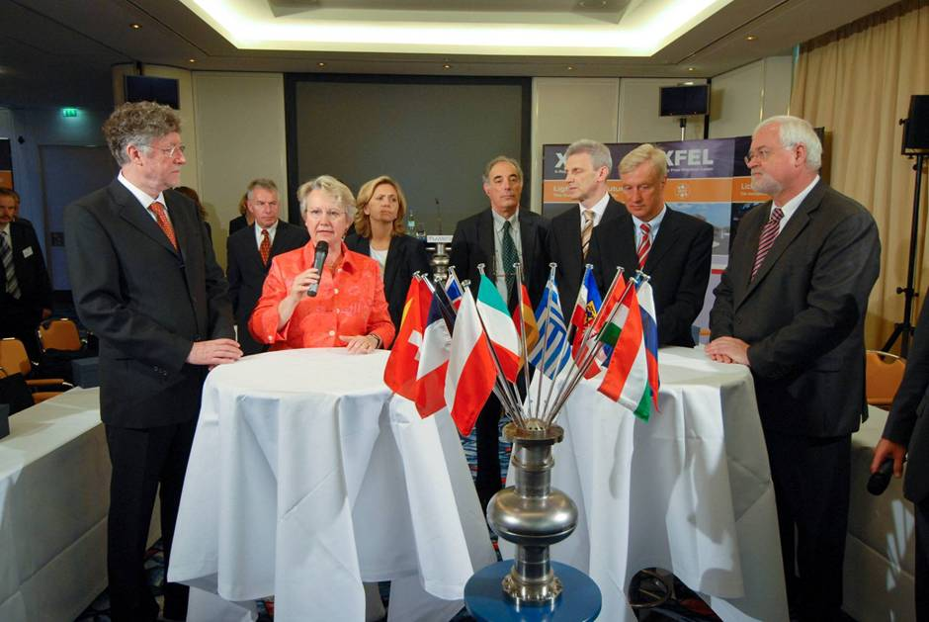
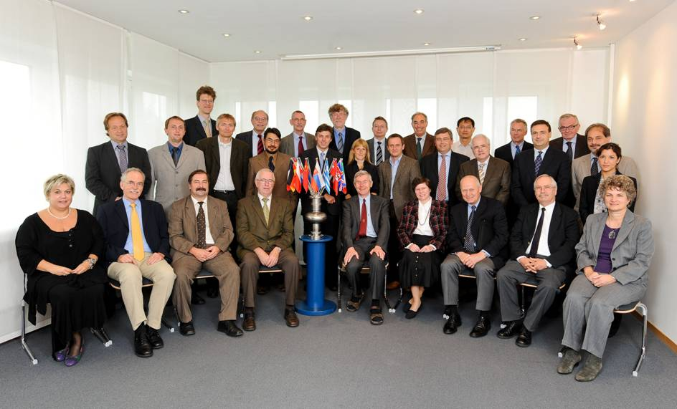
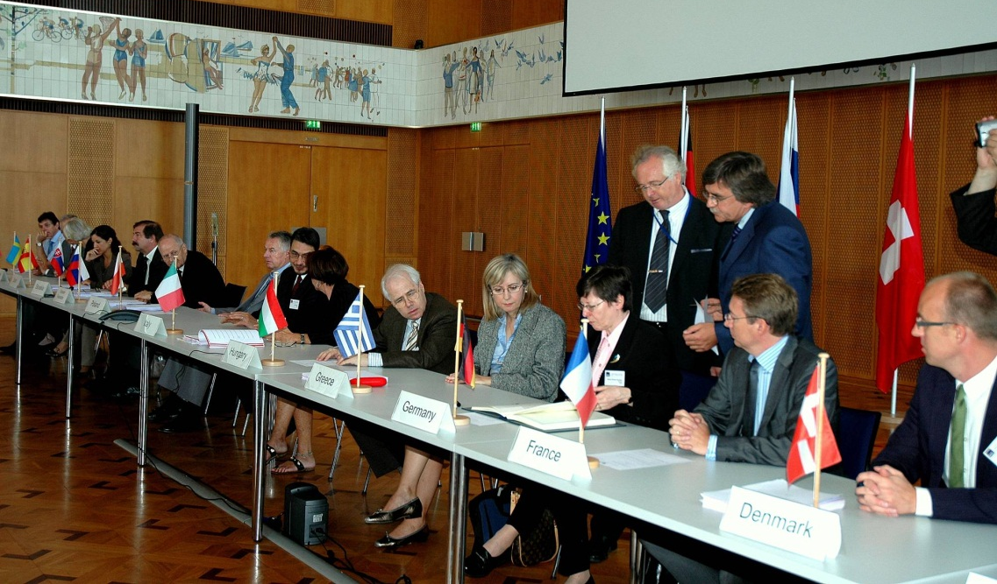
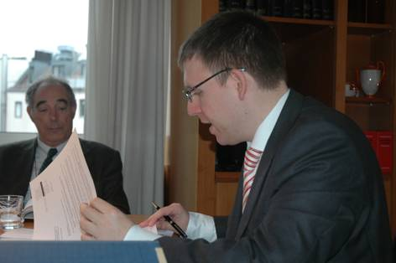
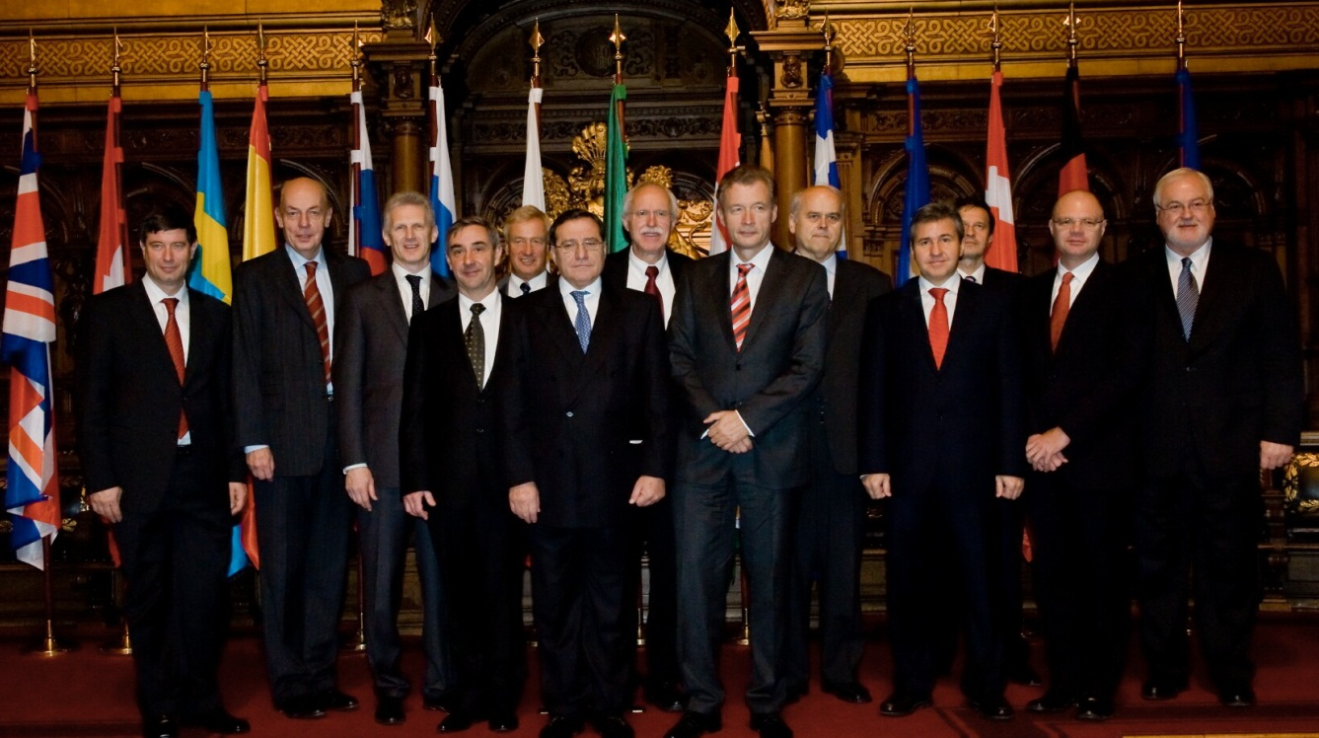
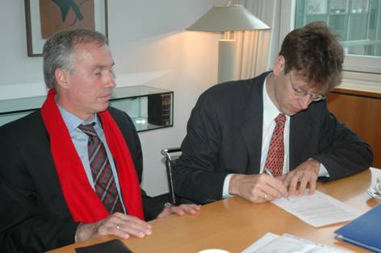
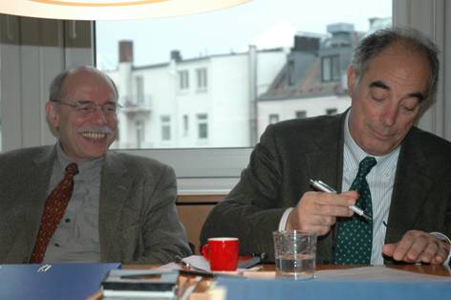
The long and winding road from the MoU to the Convention
Berlin, June 30, 2006: TDR completed, legal texts “quasi final”
Hamburg, Jun 05, 2007: Launch event
Hamburg, Sep 22, 2008: Founding documents completed
Berlin, Sep 23, 2009: Initialling of founding documents
Hamburg, Sep 28, 2009: Foundation of European XFEL GmbH
Hamburg, Nov 30, 2009: Signing of International Convention

Slide 15
Legal Organisation of ESRF and XFEL here: European XFEL
Comparison of legal difficulties/advantages of ESRF and European XFEL
DESY alone founded the Company; so far 10 + 2 (FR, ES) Governments signed the Convention; 5 + 2 (HU, PL) shareholders joined DESY.
Germany
DESY
VR
Sweden
France
CNRS
CEA
DASTI
Denmark
Italy
Republic of Italy
RUSNANO
Russia
Spain
Kingdom of Spain
IPJ
Poland
Switzerland
Swiss Confederation
NKTH
Hungary
Slovakia
European
XFEL
Slovak Republic

Slide 16
Legal Organisation of ESRF and XFEL
Comparison of legal difficulties/advantages of ESRF and European XFEL
Foundation of the European XFEL Company by DESY alone, joining of further shareholders in several steps (threshold: 1%)
Date | Contracting Party | Shareholders | Shares | In %
28 Sept. 09 | Fed. Rep. of Germany | DESY | 16 262 | 65.05
30 Nov. 09 | Russian Federation | RUSNANO | 6 561 | 26.24
 | Kingdom of Sweden | Vetenskapsrådet | 420 | 1.68
 | Swiss Confederation | Swiss Confederation | 394 | 1.58
 | Kingdom of Denmark | DASTI | 289 | 1.16
 | Slovak Republic | Slovak Republic | 250 | 1.00
10 May 10 | Republic of Hungary | NKTH (➔ NIH) | 278 | 1.11
2 Sept. 10 | Republic of Poland | IPJ (➔ NCBJ) | 546 | 2.18
 |  | Total | 25 000 | 100.00

Slide 17
Comparison of legal difficulties/advantages of ESRF and European XFEL
Legal Organisation of ESRF and XFEL
Why Limited Liability Company (GmbH)?
Again: legal identity under national law in order to avoid high cost of intergovernmental institute
Request for limitation of liability of the partners ➔
Limited Liability Company (GmbH): provides flexibility of legal embodiment, although more adapted to commercial companies, or
Public Limited Company (Aktiengesellschaft): regulations are more cumbersome
whereas
Civil law partnership (GbR): too loose for long-term business, no restriction of liability
Foundation (Stiftung): not appropriate for international RI, legally rather independent from its founders

Slide 18
Thank you for your attention

