Slide 1
Research Infrastructures:
Making the case and setting the scene
Carlo Rizzuto
Sincrotrone Trieste

Slide 2
Definition of a Pan-EU RI (ESFRI)
A “Facility” for service to “Research” which:
Offers cutting-edge, essential service to research, on a non-economic basis, within an ERA outlook;
Awards free open access through international peer-review competition at world level;
Results published/shared in the public domain;
Proprietary and/or training access is marginal;
Clear pan-European added value: e.g. at least 30% of selected users coming from non-host countries.
Can be single sited, distributed, virtual;… lifetimes between years (satellites) and centuries (libraries)…

Slide 3
Why are we here?
RIs are needed in all science fields
No single EU Country can provide them all
While other Nations can: e.g.: India, US, China…, (only in few cases global approach needed)
Europe must compete with them as a Union
Most EU Countries can contribute with their RIs or by participating in joint ones
We need to develop, operate, upgrade,reorient, … pool, limited resources, as an overall EU “system”
This requires common understanding and “culture”
And this is the scope of RAMIRI

Slide 4
Research: what does it mean?
Political + media discourse mix together, under the name of “Research”, three activities with very different goals & economic aspects: Research, Development, Innovation
These are well defined by international rules:
Research: produces new knowledge, i.e. discoveries (previously unknown!!, i.e. unpredictable) : (very rare economic return to investor: 100% public allowance)
Development: produces new solutions, i.e inventions* , by the use of existing knowledge: (some economic return to investor, albeit risky: ≈50% public allowance)
Innovation: successfully improves existing solutions (economically self-sustaining: <≈25% allowance), rarely connected only to S&T, but often to finance, marketing, organization,…….
*new products, processes, methods,….

Slide 5
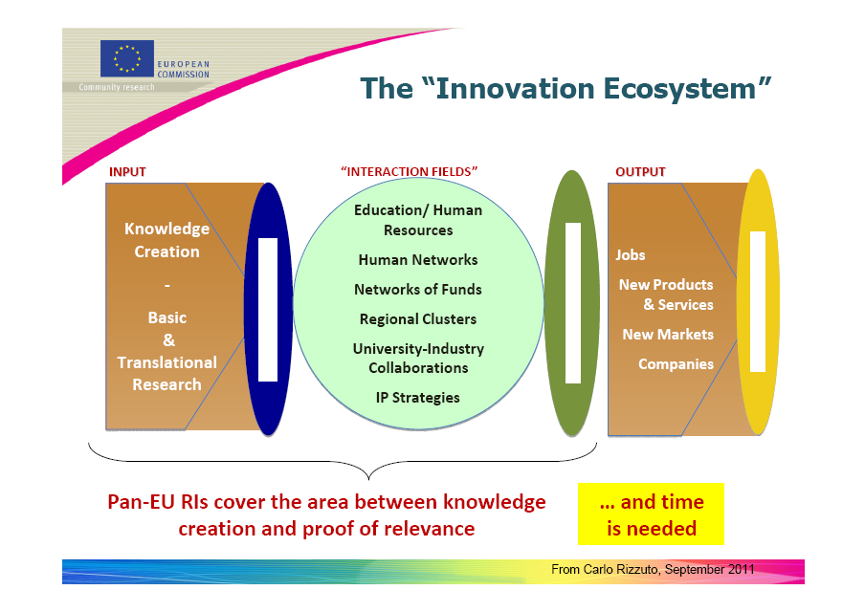

Slide 6
Research, Development and Innovation: which drivers?
Driver to new knowledge: mainly curiosity and exploring (other motivations are less driving)
Driver to inventions: need to solve a problem (economic, defense, sport,…..research)
Driver to innovations: need to win (a market, a challenge, a competition,……and in research!)
Research is a powerful driver for Development (D), for Innovation (I)….and Education (E).
Success is based on “peer competition ”: same driver!
This is why RIs MUST offer “open access” for R: owners will reap benefits in D, I, E (and improve their R)

Slide 7
Therefore…..
Research Infrastructures are “non economic” (Research is a non self-sustaining activity)
But…if they compete to be attractive at world level, then: they must continuously “develop”, “innovate”, “educate”: these parts can provide economic gains.
International RIs need special qualities to be attractive and need to please many “stakeholders”, each one expecting a different part/taste of the “pie”
Planning, governing, managing RIs means to understand all stakeholders, respond and account in the most complete and effective way: therefore RIs are also powerful drivers of quality in Management!

Slide 9
Development Infrastructures
Some infrastructures imply (mainly) Development activities, but often are called RIs (and sold as such):
The International Space Station and ITER
A Formula 1 car and most “test facilities” (e.g. wind tunnells, simulation chambers, etc)
A joung Marconi developing the Radio…
Most industrial “applied research” is, in fact “development”
Its main driver is “relevance” as well as quality,

Slide 10
Returns and Stakeholders
More funding
to research
(structural&industl)
Industry-University
collaboration
(by open access)
New scientific
Knowledge
new science
opportunities
Construction
and competitivity
of ERA
Improved public
research
expenditure
Improved education
& training
opportunities
Attraction
of private funding
Possible
proprietary use
Technology
and innovation
opportunities
Political visibility
and success
Business opportunities
Attraction of industries
Spin off companies
International
RI
Attraction of
students to Science
High quality public
Procurement
Higher tax income
Improvement of
Regional resources
Brain exchange
Instead of
brain drain
Improved
environmental aspects
Scientific tourism
Higher staff mobility
with industry
Improved
local infrastructure
(transport, energy,
housing,...)
Jobs and employment,
Local expenditure

Slide 11
....with different motivations
(anthropology of the stakeholders)
Science
community
Political
environment
Regional
environment
Industrial
environment
New science
opportunities
Construction of
ERA
Attraction of
industries&
private funding
Technology
and innovation
opportunities
Improved public
research
expenditure
Improved
local infrastructure
(transport, energy,
housing,...)
Business
procurement
opportunities
education&training
opportunities
Construction of
ERA
Political visibility
and success
Jobs&employment
+local expenditure
Possible
Proprietary
use
More funding
to research
& industry support
Higher tax income
& attraction of
Private funding
Improved
environmental
aspects
Industry-research
collaboration
(through open access)
Increasing economic motivation

Slide 12
The picture is a bit more complex
The “academia”
Excellence is
forever
Pure science should
be isolated
Strong lobbiers
Opinion makers
What is in it for me?
Taking away from me?
Against any large
initiative
Very fragmented
Mono or multi
Science
“community”?
The friend of the
local politician
Very organized
monodisciplinary
International,
National,
Local
What is this
bureaucracy?
Typical researcher
= most conservative
“animal”
Different institutions
Uni. Acad. Res. Ctre
= different agendas
Majority: don’t ask
Don’t say

Slide 13
The picture is a bit more complex
the industry
Looking for
strategic alliance
One off supplier
Interested in
technical training
Very fragmented
SMES
Industrial
environment?
Interested in
co_developing
Looking for
Govt money:
competitor
Rarely: interested
in using the RI
R&D of multinational
Beware competition!
Majority: don’t ask
don’t say
(but believing
RI useless)
Political
Environment?
Regional
environment?

Slide 14
Summary
Our problem is:
How can we explain? (not always data available)
How can we obtain? (fund raising, and best use)
How can we ensure results? (and get sustainability)
How can we manage a complex environment…
……..to achieve something which is very different from “normal” economic culture?
Which are the “narratives” and “best practices” used until now?: can they be improved?

Slide 15
examples of “narrative”
Who invented the RI’s? (in the middle ages…)
What other accepted activity is popularly known and similar enough? (Olympic games…)
How can “open access” be justified?
How are socio-economic returns optimized?
………..And now let’s work seriously!

Slide 16
RESOURCES
Financial resources
What are the current and potential sources of revenue for our activities?
What is the agenda of the funders?
What do they expect from our activities?
How to reach and convince them?
Non-financial resources
Do we have sustainable access to technology / scientific know-how do we need?
What is our training strategy? Is it adapted to the phases of our activity?
How can we evidence the outputs and the relevance of our activities?
Do we have sustainable access to the non-financial resources we need?
ACTIVITY
Partners
Do we need partners? What for?
Do they share our strategy?
Are the partners sustainable?
How strong is our partnership?
How much do we depend on them?
Research infrastructure
What is the RI’s ‘mission’?
What is the timeframe for that mission?
What is the institutional and legal framework?
Competitors
Who are they?
How are they positioned in the field?
How can we compete against them? How can we differentiate ourselves from them?
Our offer - What content? What process of definition, monitoring and promotion?
Can we disseminate our results and generate extra revenues?
USERS & BENEFITS
Direct beneficiaries of our services
Who are they? How large is our user community?
What do they expect from a research infrastructure like ours?
What is needed to ensure their satisfaction?
Other benefits of our activities
What other benefits could our activities potentially generate?
What channels would be necessary to disseminate these benefits?
Do we have a strategy to put these channels in place?

