Slide 1
Managing access to
Virtual Research Infrastructures

Slide 2
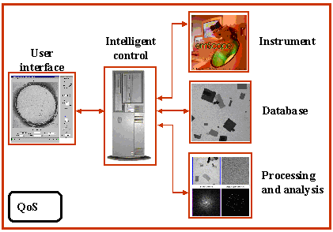
Courtesy: Beckman Institute for
Advanced Science and Technology University of Illinois

Slide 3
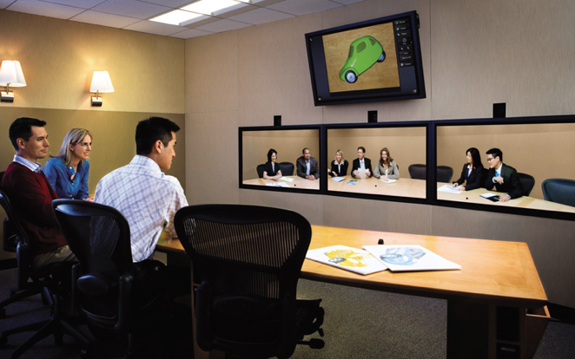
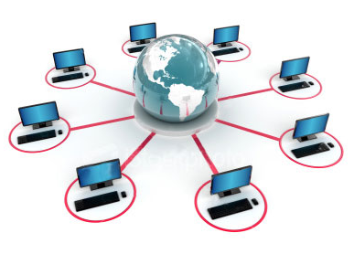
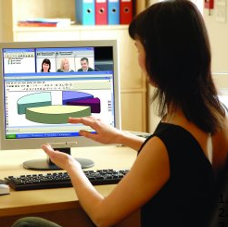

Slide 4
Management issues
Service to connect RI users (and user communities) to remote instrumentation, databases and digital analytical tools.
Support emerging clusters of users and their preferred digital environment -> virtual laboratories.
Be aware that users may want to have additional physical access.
Processing of physical access; users selection and admission.
Opportunities for on-line “publications” with direct access to research data.

