Slide 1

Key Factors of Success in the Management
of Large Research Infrastructure Projects
RAMIRI 2 Programme
Trieste, Italy, October 24th to 26th, 2011
Dr. Wolfgang Meissner
INTECH GmbH
Berlin/Germany
Notes:
Dear Gentlemen,
Why do we have to talk about key success factors in the construction management of large Research Infrastructures or RIs?

Slide 2
The overall situation:
Excellent, motivated people are working in the construction of large Research Infrastructure (“RI”) projects.
Cost overruns ( up to > 100 %), time delays ( up to > 100 %) and changes of scope are reality
  in research (often)
  in industry (sometimes, too)

Slide 3
Actually built nuclear power plants are still facing high cost increases.
Example: Cost overruns per KW of selected nuclear build projects
Costs in Euro/KW, status June 2010.
+32%
+61%
+216%
Gain of experience:
Technical
…
Managerial
*
²⁾
¹⁾
^{1), 3)}
^{1), 2)}
Estimates, projects in progress (South Texas construction not yet started)
Currency conversion date May 20th, 2010
Initial overnight estimate 2005, cost update in 6/2010
Actual cost overrun (estimation)
Initial cost estimation
Sources: Arthur D. Little, “Nuclear New Build Unveiled”, * EDF, Press Release “H1 2010 Results”

Slide 4
Important aspects in the management of large RIs.
Governance
Management
Controlling
Procurement
Aspects:
Governance
Management
Planning, Reporting & Controlling, Counter measures
Procurement

Slide 5
Governance
Management
Controlling
Procurement
Situation (at the beginning):
Engineers and scientists develop a basic concept of the RI with rough estimations
Political decisions demand fixed data
Ongoing project changes according to the project‘s conceptual development are not adequately considered (cost, time)
Consequence: the project starts and runs under optimistic assumptions/conditions

Slide 6
Governance
Management
Controlling
Procurement
Key Factor 1:
Political agreement upon a „memorandum of common understanding“ with fixed shared understanding of the foreseen scope, schedule and cost together with a phase oriented approval process
Key Factor 2:
Competent supervising boards must have clearly defined authority and responsibilities and powers of self-assertion
  to be able to control and to supervise the top management
  to immediately impact the project, whenever this is necessary
  to quickly resolve conflicts presented by the top management

Slide 7
Governance
Management
Controlling
Procurement
Key Factor 3:
Selection of the management team on the basis of project management and technical skills with large independence and authorization and with full responsibility.
The management must be challenged to achieve the project goals within the given cost and time frames
The supervising boards should implement independent scientific and technical audits and external, professional project control.

Slide 8
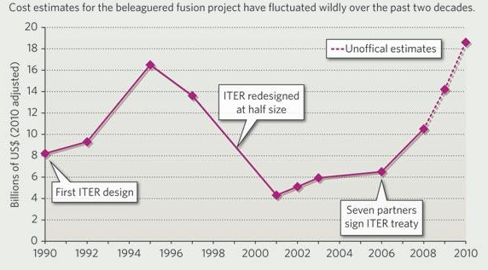
The ITER project needs severe changes…
Governance
Management
Controlling
Procurement
Example: ITER Cost increase
Costs in Billions of US $, 2010 adjusted
Source: Nature 465, page 532-533 (2010), online publication 28 May 2010

Slide 9
Governance
Management
Controlling
Procurement
Situation (after the start):
The project starts with limited resources (cash, personal).
Structures and processes still have to be defined and modified according to the project’s growing.

Slide 10
Governance
Management
Controlling
Procurement
Key Factor 4:
A clear and structured organization with respect to its growth is necessary
(structure and processes).
The management must ensure
  the implementation of full responsibility at every level
  direct, transparent reporting lines
  the full use of management and project tools
The project must install processes
  to decide quickly upon technical, cost and time aspects
  to react quickly on technical, cost and time deviations by elaborating and controlling necessary countermeasures

Slide 11
In early phases component orientation and coordination dominate.
Governance
Management
Controlling
Procurement
Example: Organizational chart (early phase)
Organization dominated by component design and procurement
Procurement
Project
(Procurement phase)
Office
Cross divisional function
Component orientated
Assembly orientated
Project
Coordination
Coils
Magnet System
Cryostat
In-Vessel Components
Cryogenics
Machine control /operation preparation
Assembly
Construction
planar
Coordination
Inner vessel
Component
type 1
Thermal insulation
Central machine control
Integration planning
Enterprise
Non planar
Power Supplies
Outer vessel
…
Component colling
Control room & communi-cation
Metrology
Electrical grounding
Ports
Component type n
Current leads
Component control
Periphery
Mechanical Structure
Operating surveillance
LHe
supply
Gas inlet
Tools
CAD support
Vacuum technics
Refrigerant storage
Machine Control
Assembly

Slide 12
More cross divisional functions are necessary during completion.
Governance
Management
Controlling
Procurement
Example: Organizational chart (later phase)
Organization dominated by machine assembly
Project
(Assembly phase)
Cross divisional function
Component orientated
Quality Management
Assoc. Director Coordination
Technical Services
Assembly orientated
Project
Coordination
Design and Configuration
Engineering
Assembly
Device components
In-Vessel Components
Physics
Project Control
Design Office
Design Engineering
On-Site
Co-ordination
Power
Supplies
Unit 1
Diagnostics
Documentation
Configuration Space Control
Development and Test
Device Assembly
Cryostat
Unit 2
Diagnostics-Engineering
Device
Safety
Configuration Management
Instrumen-
tation
Periphery
Cryogenics
Heating I
Assembly Technology
Heating 2
Machine Control

Slide 13
Governance
Management
Controlling
Procurement
Situation (during construction):
Costs and time aspects are roughly estimated at the project’s start.
Insufficient up dates are conducted in the following phases.
Sufficient contingencies in costs and time are often not foreseen or not accepted.

Slide 14
Realistic Planning is necessary.
Governance
Management
Controlling
Procurement
Key Factor 5:
Costs and time schedules must clearly be defined and realistically planned for all project phases from the very beginning onwards.
The costs and time schedules must be estimated with appropriate precision according to the different approval phases.
Phase related contingencies must be provided.

Slide 15
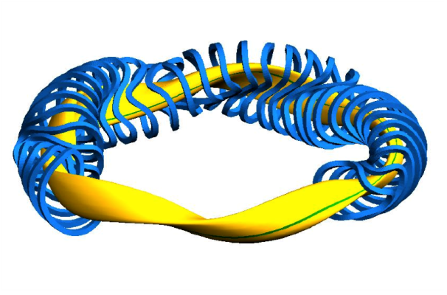
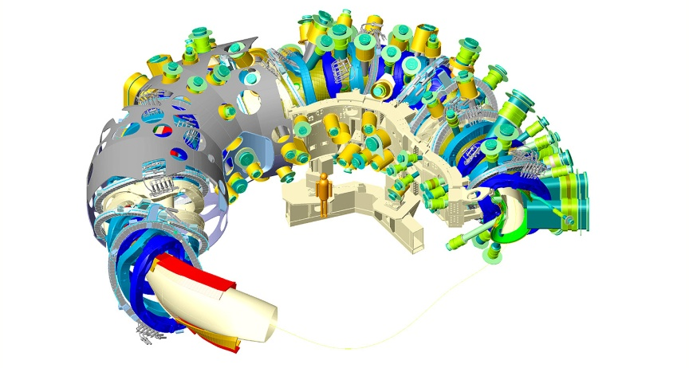
The more completion the more complexity, deeper knowledge and …contingency consumption!
Governance
Management
Controlling
Procurement
Example: Development of machine design during project development
Approval phase: Concept
Assembly phase: Detailed design
Procurement phase: Conceptual design

Slide 16
Effective “online” systems for controlling and steering/counter steering must be consequently applied.
Governance
Management
Controlling
Procurement
Key Factor 6:
An always current, bottom-up planning, controlling and reporting system based on work breakdown structures and financial management tools is mandatory.
  This integrated system must show all the planned and actual, weekly updated data and the resulting deviations
Efficient project control and risk management systems have to be fully embedded in the project, covering technical, financial and schedule issues, together with the parallel development of mitigating measures in case of deviations.
This is essential to allow the management
  to react immediately
  both internally and externally (for suppliers and in-kind contributors).

Slide 17
Processes: Implementation of a comprehensive bottom up – Planning, Controlling and Reporting Process
Governance
Management
Controlling
Procurement
Example: Wendelstein 7-X Fusion Reactor IPP/Greifswald:
Bottom up Planning Process
Boards
Top down: Budgeting
Approval or "Iteration“, (Automatically) Creation of Reporting
Project
Coord.
Approval or „Iteration“
Bottom up planning during the period (in detail)
Div. Head
Div. Head
Approval or „Iteration“
Group
Leader
Group
Leader
Group
Leader
Group
Leader
Planning of Work Packages
+
+
+
+
Resp. Officer
Resp. Officer
Resp. Officer
Resp. Officer
Resp. Officer
Resp. Officer
Resp. Officer
Resp. Officer
Resp. Officer
Resp. Officer
Resp. Officer
Resp. Officer

Slide 18
Planning- and controlling tools in combination with work breakdown structures (WBS) and different data flows.
Governance
Management
Controlling
Procurement
Example: Functional Concept of Financial Planning- and Controlling Tools
Actions:
Monthly approval of plans
Optional monthly planning and/or approval of deviations of basic plan
Monthly Planing
Monthly information according to structured input
Dataflow:
Management Information System
(for General Director, supervising committees, etc.)
Output: planning of revenues
Fin. Dpmt
Output: approval
Input:
actual plan, basic plan, actual, committments, deviations
PC
Planningstool
Output: approval
Input:
actual plan, basic plan, actual, committments, deviations
Div Head
Div Head
Output: approval
Input:
actual plan, basic plan, actual, committments, deviations
GL
GL
GL
GL
Output: planned data
Input:
approval information, SAP-data
Resp. Officer
Resp. Officer
Resp. Officer
Resp. Officer
Resp. Officer
Resp. Officer
Resp. Officer
Resp. Officer
Resp. Officer
Resp. Officer
Resp. Officer
Resp. Officer
Actual data of orders (monthly), purchase committments and budgets
ERP (e.g. SAP)
18

Slide 19
Action oriented work breakdown structures (WBS) are the basis
… also for counter steering.
Governance
Management
Controlling
Procurement
Example: Comparison: Plan vs. Actual (weekly updated!)
MS-Project file with detailed WBS with linked tasks and completion data.

Slide 20
Continuous calculation of plan deviations, automatically, weekly updated mitigate surprises and allow flexibility.
Governance
Management
Controlling
Procurement
Example xyz Company: Deviation variance baseline (budget/actual plan)
Output Monatsplanung
Stand Experimente 5:
Experimente 5
Stand Verwaltung:
Cash Outflow (Total Year)
Anticipated under-usage of planned cash outflow. Observable at beginning of year for total year (analog for total project period)
=> Counter action !
in EURO
270.000
30.000
300.000
40.000
260.000
200.000
50.000
10.000
Budget
Delta Budget
Adjusted Budget
Thereof Forecast
Thereof Actual
Forecast = Actual (YTD) + Forecast
(Rest of the year)
Thereof Purchasing Orders
Delta adjusted Budge t / Forecast
Budget
Delta Budget
Adjusted Budget
Delta Adjust. Budget/Forecast
Forecast = Actual (YTD) + Forecast (Rest o. year)
Thereof Purchasing Orders
Thereof Forecast
Thereof Actual
270.000
270.000
260.000
60.000
10.000
30.000
300.000
40.000
260.000
200.000
50.000
10.000

Slide 21
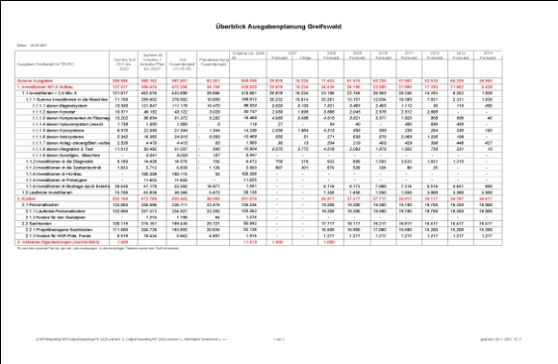
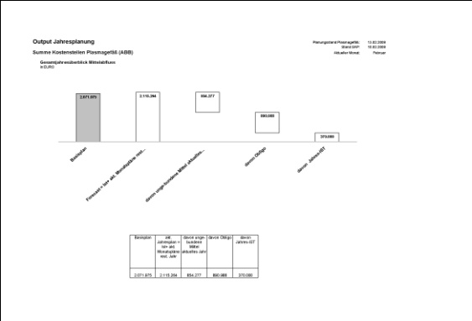
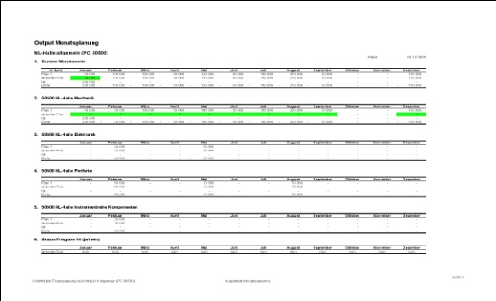
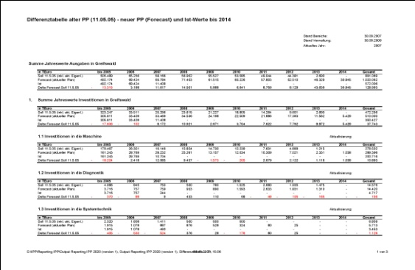
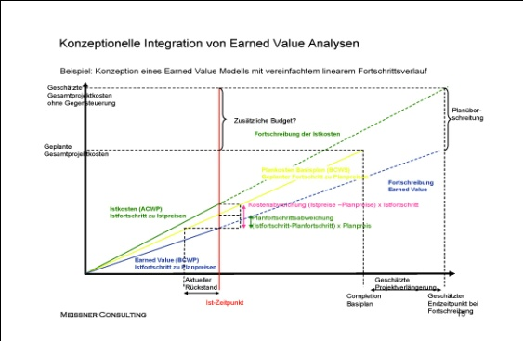
Quick, easy and comprehensive reporting systems automatically generated: the basis for steering and counter steering.
Governance
Management
Controlling
Procurement
Output-Examples for Management Information System
Customized project plans and overviews
Deviation analyses
Plans (monthly, quarterly)
Automatical generation on the basis of structured, fixed inputs
Overall project view
Wished detailed analyses: e.g. Earned Value

Slide 22
Governance
Management
Controlling
Procurement
Situation (7):
The project needs leading edge products, which can be delivered only by a very limited number of suppliers.
First of its kind components, technologies and production methods are specified not as detailed as necessary.
The project is expecting that the supplier is delivering the ordered component or service on the basis of the agreed specifications in time, in cost and in the expected quality. Surprises occur …

Slide 23
Governance
Management
Controlling
Procurement
Key Factor 7:
The responsibilities of all suppliers for deliverables must be contractually fixed in a detailed way based on detailed specifications and drawings.
The project must have full access to all relevant information on a daily basis
  technical
  financial (probable exception: in-kind contributions)
  schedule related
The same planning and controlling tools should be applied as internally (technical, financial, schedule related, technical).

Slide 24
The suppliers must be controlled and managed by the same tools as internally applied (e.g. weekly updated WBS)
Governance
Management
Controlling
Procurement
Example: Comparison: Plan vs. Actual (weekly updated!)
MS-Project file with detailed work breakdown structure (WBS) with linked tasks and completion data.

Slide 25
Suppliers must be managed by in process control, operational milestones must be monitored weekly/monthly.
Governance
Management
Controlling
Procurement
Example: Generic milestone trend analysis (MTA)
Report date
Milestone date

Slide 26
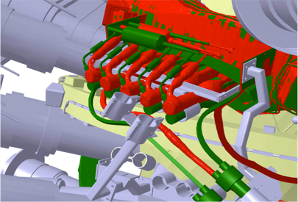
Deviations (technical, schedule, cost) occur all the time: Counter steering behavior together with effective tools and processes is mandatory.
Governance
Management
Controlling
Procurement
e.g.: Design & Engineering:
Difference between “planned” (green) and “as-built” (red) data
Example: Superconducting joints

Slide 27
Very important: Even running projects can be stabilized!
Just do it !!
Governance
Management
Controlling
Procurement
Example: Megaproject: Planned start of commissioning
Milestone-Trend-Analysis
INTECH acting as an active project tutor
Reduction of deficits
Schedule stabilization
Planned start of commissioning
INTECH Audit:
- Project deficits
- Revision of schedule
New Scenario
realistic,
not optimistic
Year

Slide 28
Outlook:
All project members are confronted day by day with many different problems …
… nevertheless, these project members will create a leading edge Research Infrastructure of which the scientific world can really be proud !

Slide 29
For further information:
Dr. Wolfgang Meissner Tel.: +49 172 3800261 meissner@intech-gmbh.de
INTECH GmbH www.intech-gmbh.de
29

